Slide 1
Chapter 1 – Software Processes
30/10/2014
Chapter 2 Software Processes

Slide 2
Topics covered
Software process models
Process activities
Coping with change
Process improvement
30/10/2014
Chapter 2 Software Processes

Slide 3
The software process
A structured set of activities required to develop a
software system.
Many different software processes but all involve:
  Specification – defining what the system should do;
  Design and implementation – defining the organization of the system and implementing the system;
  Validation – checking that it does what the customer wants;
  Evolution – changing the system in response to changing customer needs.
A software process model is an abstract representation of a process. It presents a description of a process from some particular perspective.
30/10/2014
Chapter 2 Software Processes

Slide 4
Software process descriptions
When we describe and discuss processes, we usually talk about the activities in these processes such as specifying a data model, designing a user interface, etc. and the ordering of these activities.
Process descriptions may also include:
  Products, which are the outcomes of a process activity;
  Roles, which reflect the responsibilities of the people involved in the process;
  Pre- and post-conditions, which are statements that are true before and after a process activity has been enacted or a product produced.
30/10/2014
Chapter 2 Software Processes

Slide 5
Plan-driven and agile processes
Plan-driven processes are processes where all of the process activities are planned in advance and progress is measured against this plan.
In agile processes, planning is incremental and it is easier to change the process to reflect changing customer requirements.
In practice, most practical processes include elements of both plan-driven and agile approaches.
There are no right or wrong software processes.
30/10/2014
Chapter 2 Software Processes

Slide 6
Software process models
30/10/2014
Chapter 2 Software Processes

Slide 7
Software process models
The waterfall model
  Plan-driven model. Separate and distinct phases of specification and development.
Incremental development
  Specification, development and validation are interleaved. May be plan-driven or agile.
Integration and configuration
  The system is assembled from existing configurable components. May be plan-driven or agile.
In practice, most large systems are developed using a process that incorporates elements from all of these models.
30/10/2014
Chapter 2 Software Processes

Slide 8
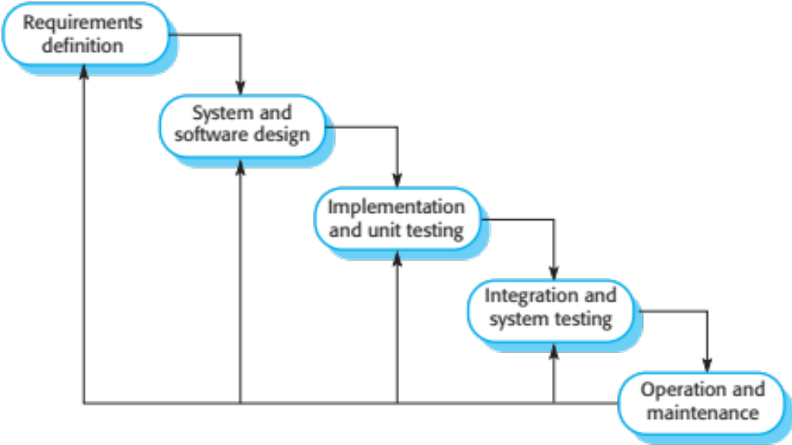
The waterfall model
30/10/2014
Chapter 2 Software Processes

Slide 9
Waterfall model phases
There are separate identified phases in the waterfall model:
  Requirements analysis and definition
  System and software design
  Implementation and unit testing
  Integration and system testing
  Operation and maintenance
The main drawback of the waterfall model is the difficulty of accommodating change after the process is underway. In principle, a phase has to be complete before moving onto the next phase.
30/10/2014
Chapter 2 Software Processes

Slide 10
Waterfall model problems
Inflexible partitioning of the project into distinct stages makes it difficult to respond to changing customer requirements.
  Therefore, this model is only appropriate when the requirements are well-understood and changes will be fairly limited during the design process.
  Few business systems have stable requirements.
The waterfall model is mostly used for large systems engineering projects where a system is developed at several sites.
  In those circumstances, the plan-driven nature of the waterfall model helps coordinate the work.
30/10/2014
Chapter 2 Software Processes

Slide 11
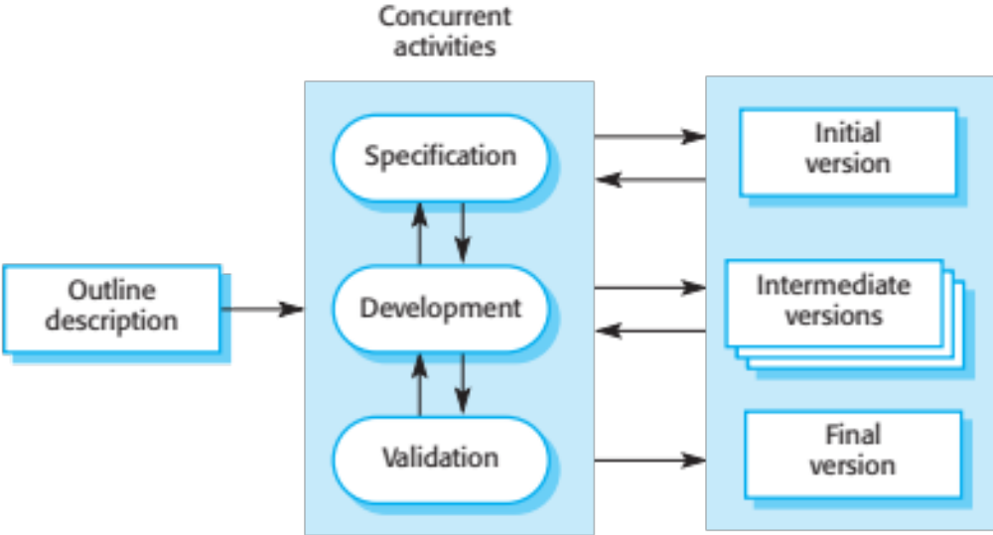
Incremental development
30/10/2014
Chapter 2 Software Processes

Slide 12
Incremental development benefits
The cost of accommodating changing customer requirements is reduced.
  The amount of analysis and documentation that has to be redone is much less than is required with the waterfall model.
It is easier to get customer feedback on the development work that has been done.
  Customers can comment on demonstrations of the software and see how much has been implemented.
More rapid delivery and deployment of useful software to the customer is possible.
  Customers are able to use and gain value from the software earlier than is possible with a waterfall process.
30/10/2014
Chapter 2 Software Processes

Slide 13
Incremental development problems
The process is not visible.
  Managers need regular deliverables to measure progress. If systems are developed quickly, it is not cost-effective to produce documents that reflect every version of the system.
System structure tends to degrade as new increments are added.
  Unless time and money is spent on refactoring to improve the software, regular change tends to corrupt its structure. Incorporating further software changes becomes increasingly difficult and costly.
30/10/2014
Chapter 2 Software Processes

Slide 14
Integration and configuration
Based on software reuse where systems are integrated from existing components or application systems (sometimes called COTS -Commercial-off-the-shelf) systems).
Reused elements may be configured to adapt their behaviour and functionality to a user’s requirements
Reuse is now the standard approach for building many types of business system
  Reuse covered in more depth in Chapter 15.
30/10/2014
Chapter 2 Software Processes

Slide 15
Types of reusable software
Stand-alone application systems (sometimes called COTS) that are configured for use in a particular environment.
Collections of objects that are developed as a package to be integrated with a component framework such as .NET or J2EE.
Web services that are developed according to service standards and which are available for remote invocation.
30/10/2014
Chapter 2 Software Processes

Slide 16
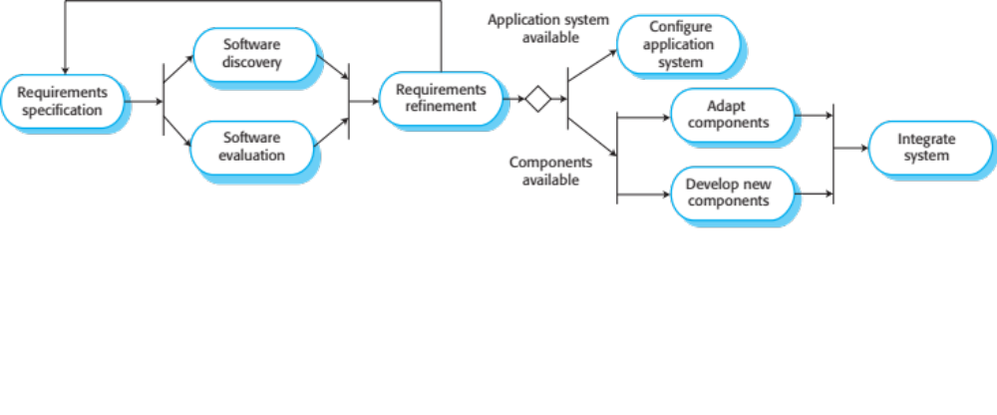
Reuse-oriented software engineering
30/10/2014
Chapter 2 Software Processes

Slide 17
Key process stages
Requirements specification
Software discovery and evaluation
Requirements refinement
Application system configuration
Component adaptation and integration
30/10/2014
Chapter 2 Software Processes

Slide 18
Advantages and disadvantages
Reduced costs and risks as less software is developed from scratch
Faster delivery and deployment of system
But requirements compromises are inevitable so system may not meet real needs of users
Loss of control over evolution of reused system elements
30/10/2014
Chapter 2 Software Processes

Slide 19
Process activities
30/10/2014
Chapter 2 Software Processes

Slide 20
Process activities
Real software processes are inter-leaved sequences of technical, collaborative and managerial activities with the overall goal of specifying, designing, implementing and testing a software system.
The four basic process activities of specification, development, validation and evolution are organized differently in different development processes.
For example, in the waterfall model, they are organized in sequence, whereas in incremental development they are interleaved.
30/10/2014
Chapter 2 Software Processes

Slide 21
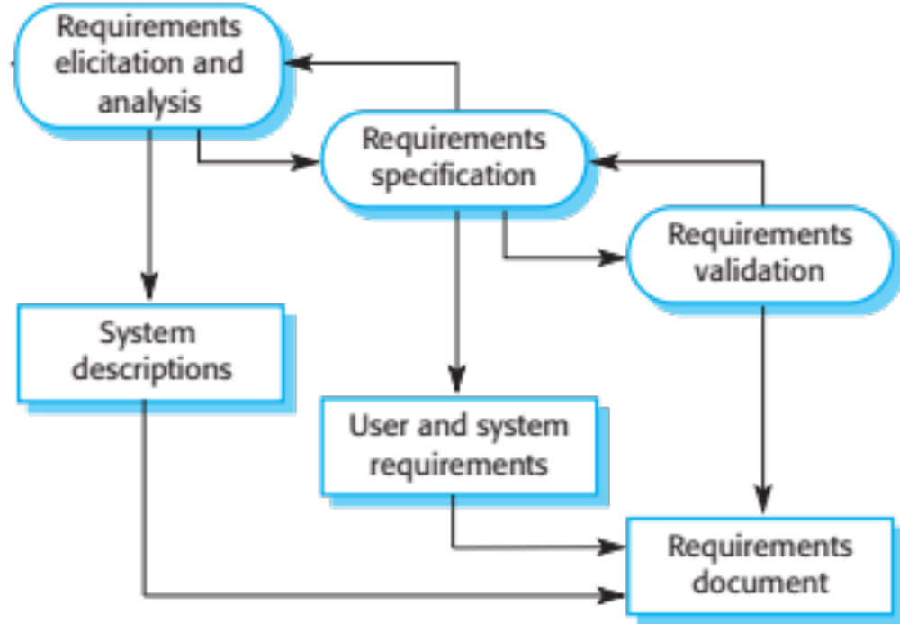
The requirements engineering process
30/10/2014
Chapter 2 Software Processes

Slide 22
Software specification
The process of establishing what services are required and the constraints on the system’s operation and development.
Requirements engineering process
  Requirements elicitation and analysis
    What do the system stakeholders require or expect from the system?
  Requirements specification
    Defining the requirements in detail
  Requirements validation
    Checking the validity of the requirements
30/10/2014
Chapter 2 Software Processes

Slide 23
Software design and implementation
The process of converting the system specification into an executable system.
Software design
  Design a software structure that realises the specification;
Implementation
  Translate this structure into an executable program;
The activities of design and implementation are closely related and may be inter-leaved.
30/10/2014
Chapter 2 Software Processes

Slide 24
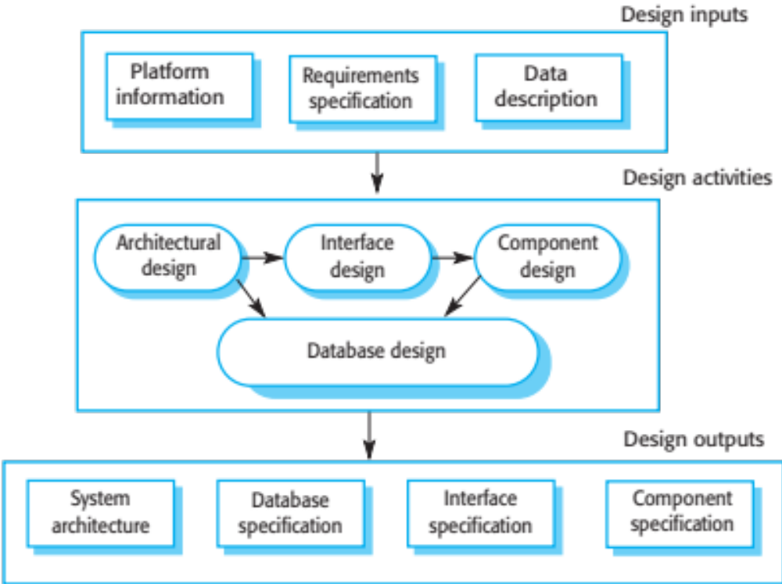
A general model of the design process
30/10/2014
Chapter 2 Software Processes

Slide 25
Design activities
Architectural design, where you identify the overall structure of the system, the principal components (subsystems or modules), their relationships and how they are distributed.
Database design, where you design the system data structures and how these are to be represented in a database.
Interface design, where you define the interfaces between system components.
Component selection and design, where you search for reusable components. If unavailable, you design how it will operate.
30/10/2014
Chapter 2 Software Processes

Slide 26
System implementation
The software is implemented either by developing a program or programs or by configuring an application system.
Design and implementation are interleaved activities for most types of software system.
Programming is an individual activity with no standard process.
Debugging is the activity of finding program faults and correcting these faults.
30/10/2014
Chapter 2 Software Processes

Slide 27
Software validation
Verification and validation (V & V) is intended to show that a system conforms to its specification and meets the requirements of the system customer.
Involves checking and review processes and system testing.
System testing involves executing the system with test cases that are derived from the specification of the real data to be processed by the system.
Testing is the most commonly used V & V activity.
30/10/2014
Chapter 2 Software Processes

Slide 28
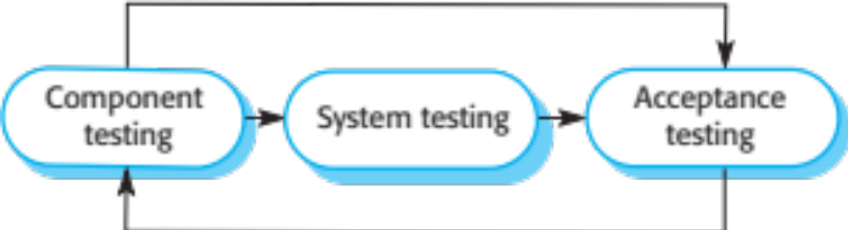
Stages of testing
30/10/2014
Chapter 2 Software Processes

Slide 29
Testing stages
Component testing
  Individual components are tested independently;
  Components may be functions or objects or coherent groupings of these entities.
System testing
  Testing of the system as a whole. Testing of emergent properties is particularly important.
Customer testing
  Testing with customer data to check that the system meets the customer’s needs.
30/10/2014
Chapter 2 Software Processes

Slide 30
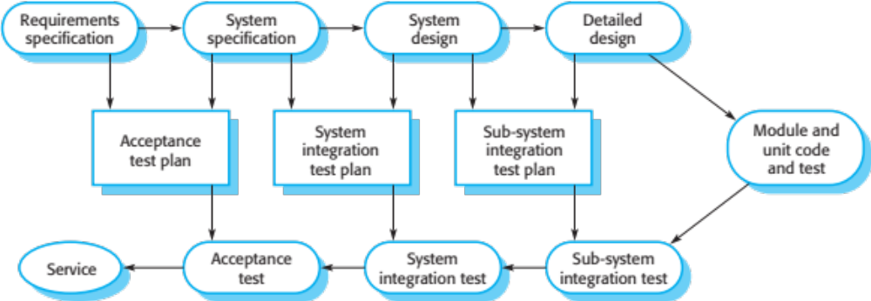
Testing phases in a plan-driven software process (V-model)
30/10/2014
Chapter 2 Software Processes

Slide 31
Software evolution
Software is inherently flexible and can change.
As requirements change through changing business circumstances, the software that supports the business must also evolve and change.
Although there has been a demarcation between development and evolution (maintenance) this is increasingly irrelevant as fewer and fewer systems are completely new.
30/10/2014
Chapter 2 Software Processes

Slide 32
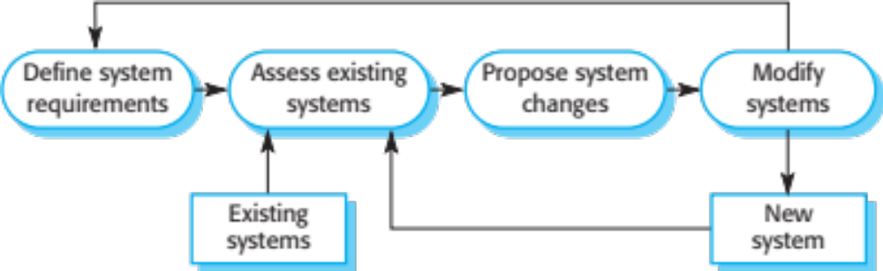
System evolution
30/10/2014
Chapter 2 Software Processes

Slide 33
Coping with change
30/10/2014
Chapter 2 Software Processes

Slide 34
Coping with change
Change is inevitable in all large software projects.
  Business changes lead to new and changed system requirements
  New technologies open up new possibilities for improving implementations
  Changing platforms require application changes
Change leads to rework so the costs of change include both rework (e.g. re-analysing requirements) as well as the costs of implementing new functionality
30/10/2014
Chapter 2 Software Processes

Slide 35
Reducing the costs of rework
Change anticipation, where the software process includes activities that can anticipate possible changes before significant rework is required.
  For example, a prototype system may be developed to show some key features of the system to customers.
Change tolerance, where the process is designed so that changes can be accommodated at relatively low cost.
  This normally involves some form of incremental development. Proposed changes may be implemented in increments that have not yet been developed. If this is impossible, then only a single increment (a small part of the system) may have be altered to incorporate the change.
30/10/2014
Chapter 2 Software Processes

Slide 36
Coping with changing requirements
System prototyping, where a version of the system or part of the system is developed quickly to check the customer’s requirements and the feasibility of design decisions. This approach supports change anticipation.
Incremental delivery, where system increments are delivered to the customer for comment and experimentation. This supports both change avoidance and change tolerance.
30/10/2014
Chapter 2 Software Processes

Slide 37
Software prototyping
A prototype is an initial version of a system used to demonstrate concepts and try out design options.
A prototype can be used in:
  The requirements engineering process to help with requirements elicitation and validation;
  In design processes to explore options and develop a UI design;
  In the testing process to run back-to-back tests.
30/10/2014
Chapter 2 Software Processes

Slide 38
Benefits of prototyping
Improved system usability.
A closer match to users’ real needs.
Improved design quality.
Improved maintainability.
Reduced development effort.
30/10/2014
Chapter 2 Software Processes

Slide 39
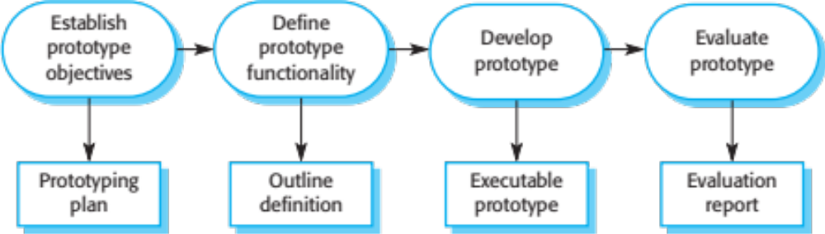
The process of prototype development
30/10/2014
Chapter 2 Software Processes

Slide 40
Prototype development
May be based on rapid prototyping languages or tools
May involve leaving out functionality
  Prototype should focus on areas of the product that are not well-understood;
  Error checking and recovery may not be included in the prototype;
  Focus on functional rather than non-functional requirements such as reliability and security
30/10/2014
Chapter 2 Software Processes

Slide 41
Throw-away prototypes
Prototypes should be discarded after development as they are not a good basis for a production system:
  It may be impossible to tune the system to meet non-functional requirements;
  Prototypes are normally undocumented;
  The prototype structure is usually degraded through rapid change;
  The prototype probably will not meet normal organisational quality standards.
30/10/2014
Chapter 2 Software Processes

Slide 42
Incremental delivery
Rather than deliver the system as a single delivery, the development and delivery is broken down into increments with each increment delivering part of the required functionality.
User requirements are prioritised and the highest priority requirements are included in early increments.
Once the development of an increment is started, the requirements are frozen though requirements for later increments can continue to evolve.
30/10/2014
Chapter 2 Software Processes

Slide 43
Incremental development and delivery
Incremental development
  Develop the system in increments and evaluate each increment before proceeding to the development of the next increment;
  Normal approach used in agile methods;
  Evaluation done by user/customer proxy.
Incremental delivery
  Deploy an increment for use by end-users;
  More realistic evaluation about practical use of software;
  Difficult to implement for replacement systems as increments have less functionality than the system being replaced.
30/10/2014
Chapter 2 Software Processes

Slide 44
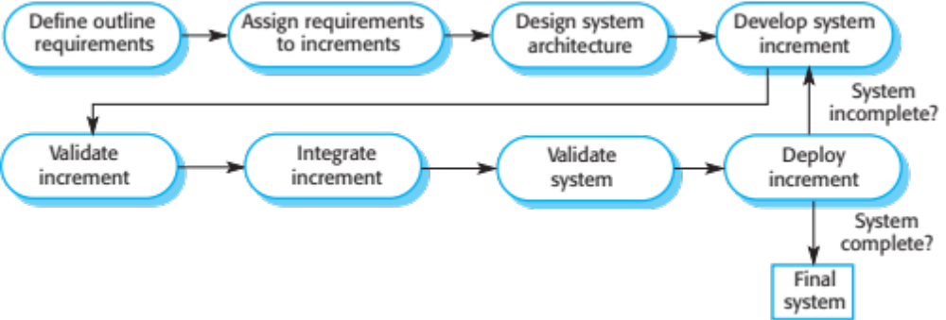
Incremental delivery
30/10/2014
Chapter 2 Software Processes

Slide 45
Incremental delivery advantages
Customer value can be delivered with each increment so system functionality is available earlier.
Early increments act as a prototype to help elicit requirements for later increments.
Lower risk of overall project failure.
The highest priority system services tend to receive the most testing.
30/10/2014
Chapter 2 Software Processes

Slide 46
Incremental delivery problems
Most systems require a set of basic facilities that are used by different parts of the system.
  As requirements are not defined in detail until an increment is to be implemented, it can be hard to identify common facilities that are needed by all increments.
The essence of iterative processes is that the specification is developed in conjunction with the software.
  However, this conflicts with the procurement model of many organizations, where the complete system specification is part of the system development contract.
30/10/2014
Chapter 2 Software Processes

Slide 47
Key points
Software processes are the activities involved in producing a software system. Software process models are abstract representations of these processes.
General process models describe the organization of software processes.
  Examples of these general models include the ‘waterfall’ model, incremental development, and reuse-oriented development.
Requirements engineering is the process of developing a software specification.
30/10/2014
Chapter 2 Software Processes

Slide 48
Key points
Design and implementation processes are concerned with transforming a requirements specification into an executable software system.
Software validation is the process of checking that the system conforms to its specification and that it meets the real needs of the users of the system.
Software evolution takes place when you change existing software systems to meet new requirements. The software must evolve to remain useful.
Processes should include activities such as prototyping and incremental delivery to cope with change.
30/10/2014
Chapter 2 Software Processes

Slide 49
Key points
Processes may be structured for iterative development and delivery so that changes may be made without disrupting the system as a whole.
The principal approaches to process improvement are agile approaches, geared to reducing process overheads, and maturity-based approaches based on better process management and the use of good software engineering practice.
The SEI process maturity framework identifies maturity levels that essentially correspond to the use of good software engineering practice.
30/10/2014
Chapter 2 Software Processes

